Slide 1

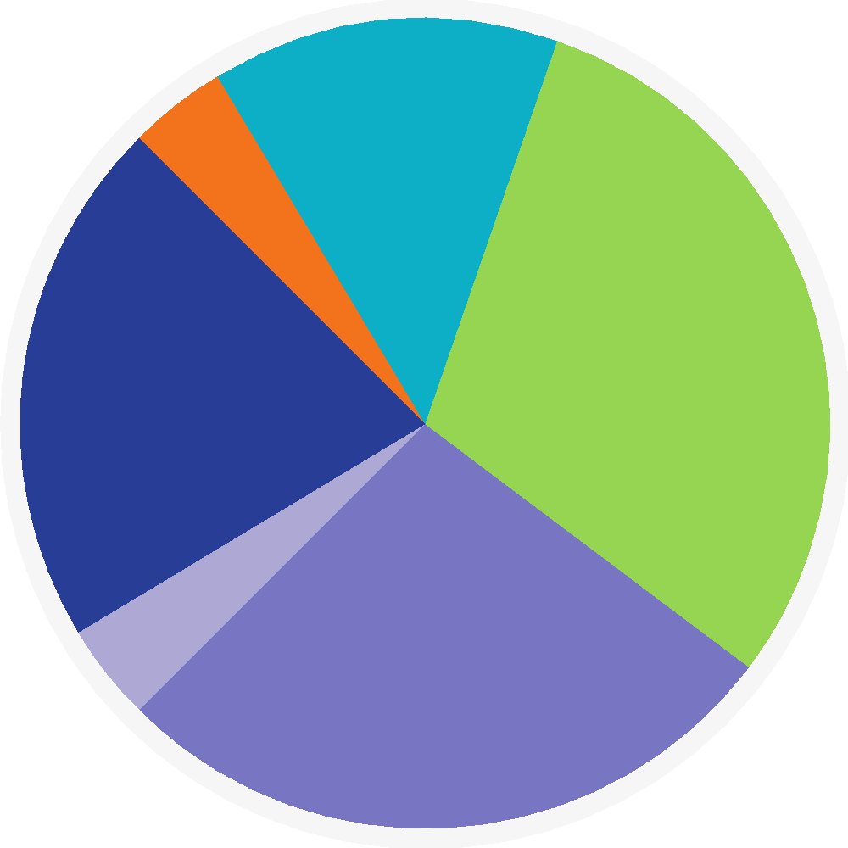
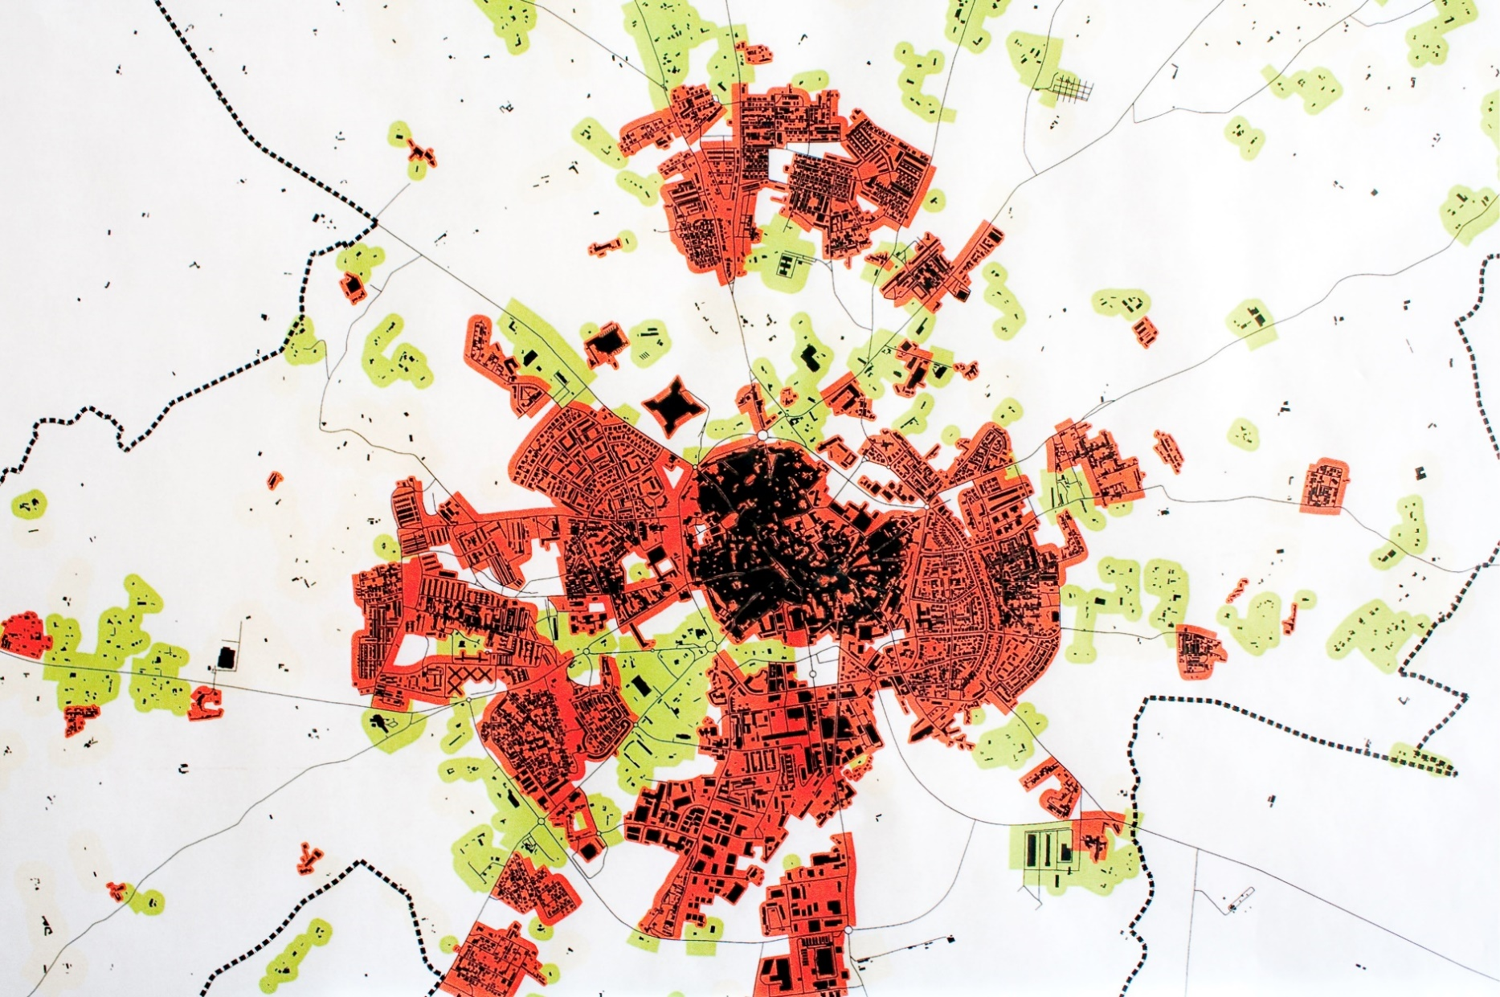


Cor Preta para títulos:
RGB(0,0,0)
Tipos (de letra):
Títulos e destaques 🡪 Roboto Medium
Corpo do texto 🡪 Roboto Light
(evitar o uso de bold; usar Roboto Medium em alternativa)
FORMATO OBRIGATÓRIO: A2
Título numa linha (preferível) ou duas (se necessário).
Advancing Research with Autonomous Boats : Collecting Aquatic Sensorial Data
Bruno Lemos, Tiago Marques
Prof. Susana Sargento e Pedro Rito
Última linha:
designação da unidade curricular, ou
grau, para as dissertações/teses, e.g.: Mestrado em Engenharia Informática
Redes e Sistemas Autónomos, 4º ano, MECT.
2023
Abstrac
The Project aims to develop an innovative autonomous data collection system for various environments. This system utilizes a fleet of specialized boats equipped with OBU's to receive valuable data from different sensores, such as water quality, weather conditions, and marine life monitoring. The boats are designed to operate efficiently and effectively, providing a cost-effective solution for gathering crucial information.
Área para o logo do projeto/trabalho, se aplicável. Deve ficar delimitado pelo quadrado indicado pelas guias.
(activar a visualização das guias)
Língua sugerida:
Português ou inglês.
Fig 2- Emulator interface
Emulator and Data Analysis
The emulator was developed for visualizing the progress of a capture mission and the subsequent data analysis. The emulator is built using React, providing a user-friendly interface to monitor and analyze the collected data(see Fig. 2).
The emulator serves as a visual representation of the capture mission, allowing users to observe the real-time progress of data collection. It presents a grid that displays the positions of the boats, base station and sensors, indicating which sensors have been collected and which are yet to be collected. Additionally, the emulator provides information about the specific sensor each boat is retrieving at the moment.
Furthermore, the emulator assesses the communication range for each boat, indicating whether the boats are within range for effective communication.
Conclusion
??????????????????????????????????? ????? ????? ????? ????? ????? ????? ????? ????? ????? ????? ????? ????? ????? ????? ????? ????? ????? ????? ????? ????? ????? ????? ????? ????? ????? ????? ????? ????? ????? ????? ????? ????? ????? ????? ????? ????? ????? ????? ????? ????? ????? ????? ????? ????? ????? ????? ????? ????? ????? ????? ????? ????? ???????????????
Coluna vertical (à esquerda) deve ficar vazia
Fig 1- Architecture
Methods
The equipment setup involved the utilization of NAP-Vanteza containers to house the necessary equipment. The boats were equipped with On-Board Units (OBUs), while Roadside Units (RSUs) were deployed at the base station . Additionally, a simulation of sensors was achieved through the use of an MQTT broker(see Fig 1).
The operation is initiated by the base station, which sends a message containing the coordinates of the sensors. The boats start their operation and establish communication by exchanging messages among themselves to determine the optimal path to the sensors, showcasing effective teamwork. The OBUs on the boats collect data from the sensors and transmit it to the base station for further analysis and processing.
????? ????? ????? ????? ????? ????? ????? ????? ????? ????? ????? ????? ????? ????? ????? ????? ????? ????? ????? ????? ????? ????? ????? ????? ????? ????? ????? ????? ????? ????? ????? ????? ????? ????? ????? ????? ????? ????? ????? ????? ????? ????? ????? ????? ????? ????? ????? ????? ????? ????? ????? ????? ????? ????? ????? ????? ????? ????? ????? ????? ????? ????? ?????
Produção do PDF da versão final:
atenção à qualidade das imagens originais: pelo menos 300dpi (cores) ou 600dpi (escala de cinzentos).
o Office 2021 permite exportar PDF (File>Export>Create PDF). Selecionar: Optimize for Printing
Conferir que o PDF produzido tem a qualidade pretendida: fazer zoom a 400% e confirmar o aspeto dos elementos do poster.
Procurar que o corpo fique alinhado pela guia, nas duas colunas.

